Slide 1

Impact of Roof Styles on Housing Prices
Using style to improve investments

Slide 2
Key Indicators
Roofing styles can seriously impact the popularity and thus pricing of housing.
Notes:
Flat, Gable, Gambrel, Hip, Mansard, Shed are in my sample dataset, with Gable and Hip being the two most popular styles.

Slide 3
Findings
The Gable roofing style is closely tied to pricing
Effect is at 0.48 with a significant difference from treatment
With an average lower price, focusing on selling lower priced and more popular styles will increase sales.

Slide 4
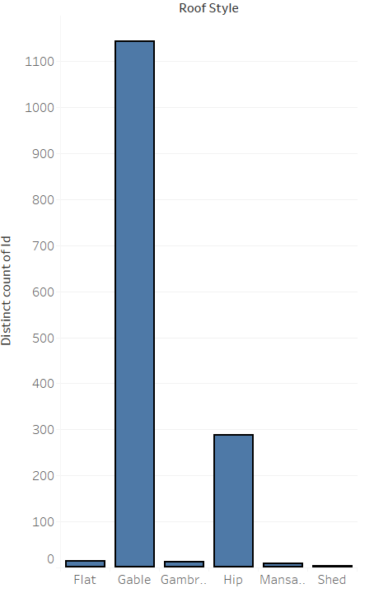
Findings
Notes:
The popularity of Gable is significantly more popular than other roofing styles, indicating a more stable investment regarding style.

Slide 5
Findings
Notes:
Control represents gable roofs, while treatment indicates non-gable roofs. While there is a higher price on average for non-gable roofs, the lower average price on gable roofs seems to drive sales.
So rather than focusing on higher priced and less popular models, we can increase stability and quantity of sales.

Slide 6
Findings
Mean | $ 171,484
Median | $ 160,000
Mode | $ 140,000
Notes:
Most people have purchased their homes for 140k where the median stands at 160k, indicating some room to increase housing prices after investment.
We could focus on purchasing below the average, and then flipping homes somewhere within the average price range.

